Slide 1
Capstone Project – 2
Supervised learning algorithms for predicting article retweets and likes based on the title
Submitted by : Anshul Vyas
Mentor : Kevin Glynn

Slide 2
Contents
Overview
Analysis
Data Exploration
Exploratory visualization
Algorithms
Data Pre-processing
Data Cleaning
Bag of words
Results

Slide 3




Overview
We are living in an era of the digital world. People are communicating and spending most of their time on social media
More than 60 per cent of social media users use this platform for news and information.
There is a requirement of a system which can predict the chances for an article to be read or loved by the audience.

Slide 4
Data Source
Dataset is taken from the accounts of the non-profit organization FreeCodeCamp on Medium and Twitter
Dataset can be downloaded from the following links:
https://medium.freecodecamp.org/
https://twitter.com/freecodecamp.org/

Slide 5
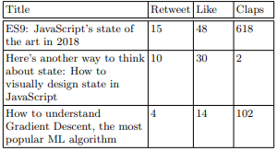
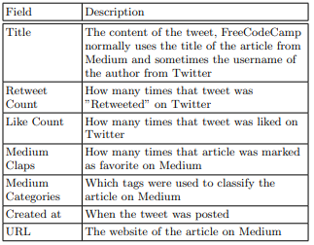
Data Exploration
The dataset has total 711 data points
Following tables shows the basic nature of the dataset:

Slide 6
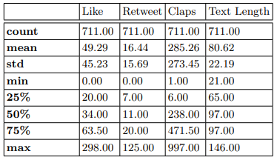
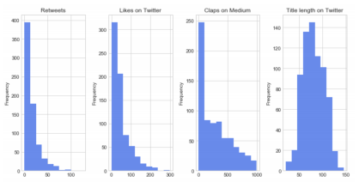
Exploratory visualization
Statistical overview:
Histogram

Slide 7
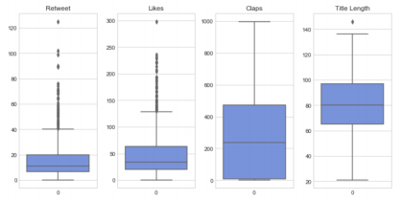
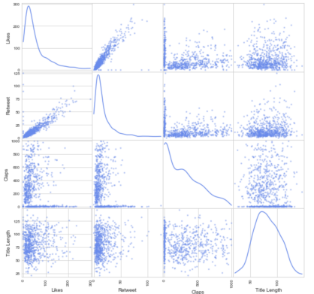
Exploratory visualization
Box plot
Scatter Matrix

Slide 8
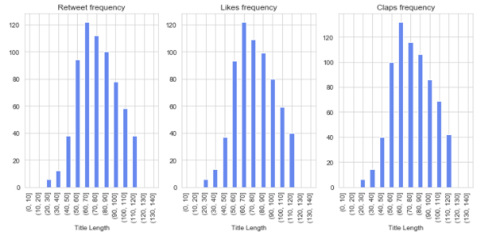
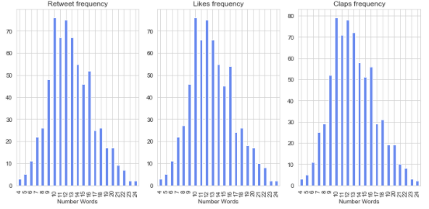
Exploratory visualization
Title length performance
Number of words performance

Slide 9
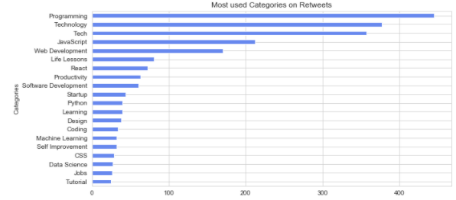

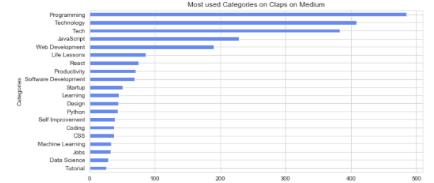
Exploratory visualization
Categories that perform better in a title

Slide 10
Algorithms
This problem ,Predicting the popularity of an article, can be considered as a classification problem
Supervised learning techniques can be used to get required results
List of algorithms used in the project:
SVM
Decision trees
Gaussian naive Bayes (GaussianNB)
K-nearest neighbours (KNN)
Logistic regression
Naive Bayes classifier for multinomial models (MultinomialNB)

Slide 11
Data Pre-processing
Assigning classes to the dataset to optimize the efficiency of classification
Ranges are :
1. Retweets: 0-10, 10-30, 30+
2. Likes: 0-25, 25-60, 60+
3. Claps: 0-50, 50-400, 400+

Slide 12
Bag of words
For the calculation of the bag of words a method, Term Frequency, Inverse Document Frequency (TF-IDF) is used
The goal is to limit the impact of tokens (words) that occur very frequently
vocabulary of 1356 words for retweets
1399 words for likes
1430 words for claps

Slide 13
Results
ID | Model | Accuracy(Like) | Accuracy(Retweet) | Accuracy(Claps)
1 | Logistic-Regression | 45.45 | 59.09 | 46.85
2 | GaussianNB | 46.21 | 49.24 | 41.25
3 | DecisionTreeClassifier | 49.96 | 50.00 | 31.46
4 | SVC | 46.96 | 56.06 | 41.95
5 | KNeighborsClassifier | 36.36 | 48.48 | 37.76
6 | MultinomialNB | 40.90 | 60.60 | 31.46
7 | GradientBoostingClassifier | 50 | 59.09 | 43.35
The final Best accuracy for each of the features are:
Likes is 50%,
Retweets is 60.60%
Claps is 46.85%.

